Slide 1

Nashville Housing Market Analysis
LiU CHENXI

Slide 2
Motivation, Data and Process:
Motivation
Understand the house value and rental trend after 2008.
Analysis the nowadays housing market. Where the Nashville housing market stand in and how much room for Nashville housing market to grow.
Critical thinking the elements that may influence the housing value.
Main data resource
Zillow
US census
fred.stlouisfed.org
Method
Python
Excel

Slide 3
Three Cities And Reasons Of Picking Up These Cities: Los Angles ; Atlanta; Nashville
Population – (US census 2020)
Los Angeles County(CA): 10,014,009
Atlanta (Fulton County, GA): 1,066,710
Nashville (Davison County, TN): 929,744
https://www.census.gov/programs-surveys/popest/technical-documentation/research/evaluation-estimates/2020-evaluation-estimates/2010s-cities-and-towns-total.html
GDP (millions)
CA: $3,290,170
GA: $673,072
TN: $411,689
Reasons of picking these 3 cities.
Los Angeles as one of major cities in the highest GDP state. It presents the ceiling for housing market.
Atlanta and Nashville are two capitals in their own states. Medians believe that the Nashville will be the next Atlanta. Atlanta and Nashville has a lot of commons from geography and weather.

Slide 4
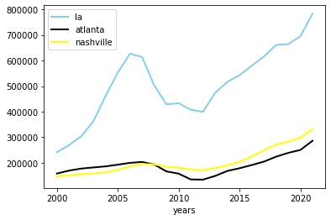
Analysis:
The Average Housing Price Trends In Three Cities( 2000-2021 )
The average house prices of Atlanta and Nashville in 2021 are close to LA in 2002 level. There is an enormous gap between LA and other two. (Considering the public translation and mobilization convenience, it might cause the gap between LA and other two.)
Nashville house average price gained 126% to comparing with Atlanta 81%
There was significant drop during the 2008-2013 in the LA and Atlanta. However, Nashville house prices didn’t receive the same impact.
The average housing price in Nashville as investment is attractive in total.
- Zillow

Slide 5
Rental Costs In Three Cities (graph 1) - Zillow
Year | LA | Atlanta | Nashville
2014 | 1776.5 | 1099 | 1167
2015 | 1899 | 1153.5 | 1250
2016 | 2021 | 1222 | 1319.5
2017 | 2127 | 1290 | 1368.5
2018 | 2219 | 1365.5 | 1407.5
2019 | 2304.5 | 1444 | 1466
2020 | 2322.5 | 1500.5 | 1509.5
2021 | 2430.5 | 1708 | 1642.5
Changes(2021 – 2014): | 654 | 609 | 475.5

Slide 6
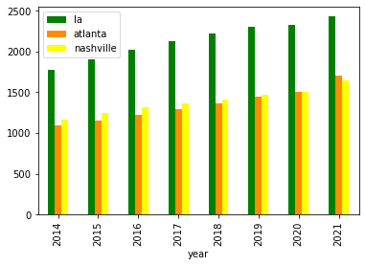
Analysis:
The cost of rental in 3 cities are getting mor expensive each year. The cost in Atlanta and Nashville as same as LA in 2014,
From the graph-1, the cost in Atlanta and LA increased the same level in 7 years in the average. The rental in Nashville still have room to grow.
In graph-2,The average of Nashville is slightly higher than Atlanta until 2021.
Considering the population and city size, the investing house as rental property in Nashville is attractive to the buyers and builders for coming years.
- Zillow
The Average Rental Cost Trends In Three Cities( 2000-2021 ) (graph 2)

Slide 7
The Possible Elements That Influent The House Price - Mortgage Rates
The Mortgage was 8.15% in 2000 and 3.1% in 2021 now. The changes between 20 years is 5.05%
The average rate from 2008 – 2010 was 5.26%. The 2019 – 2021 is 3.34%.
US Federal Reserve more likely keep the same rates until 2022 or 2023. The potential buyers will show more interesting by the low rates in general
Question: What will happen if the Mortgage rate back to the 2008 -2010 level?
- fred.stlouisfed.org

Slide 8
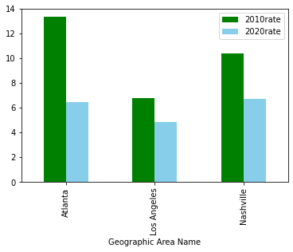
The Possible Elements That Influent The House Price – Housing Unit Vacancy Rate in Metro areas
Housing Unit Vacancy Rate From 2010 – 2020
According to Bloomberg, the health housing vacancy rate is 6%-7% (Bloomberg.com)
LA has surprisingly low vacancy rate in 3 cities and significantly getting lower during the decade.
Atlanta has the biggest difference from 13.34% in 2010 to 6.46% in 2020. Nashville vacancy rate reduced 3.69%.
Nashville housing vacancy rate is in the healthy rate. Therefore, the market has no supply issue to meet demand. Before other conditions changing, there may not cause big changes for Nashville to keep health vacancy rate while the city developing and population growth.
US Census
https://www.investopedia.com/terms/v/vacancy-rate.asp#:~:text=Vacancy%20rates%20are%20a%20very,to%20the%20area's%20vacancy%20rate.&text=Low%20vacancy%20rates%20mean%20there,a%20certain%20building%20or%20area.

Slide 9
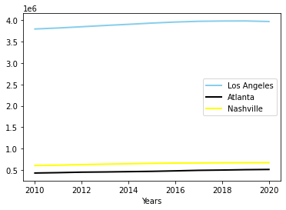
The Possible Elements That Influent The House Price – Population growth
Population changes From 2010 – 2020
None of cities population growth showing the booming growth rate.
The population in Nashville metro doesn’t grow as Media news expected. The Nashville Metro area has more population than Atlanta.
From the rental data, Nashville metro rental still lower 30% than Atlanta which the population level is higher.
we can expect the rental price in Nashville Metro area will be increasing during the years to match Atlanta level. However, the population that would like to live in the Nashville Metro area may show the opposite way and may drive the house value and rental costs higher.
- Us census

Slide 10
Summary:
Nashville metro housing marketing is still health level, and it doesn’t have supply issue to meet supply due to the vacancy rate.
The low mortgage rate will keep attracting potential buyers and builders as long as Federal Reserve would not change it in the currently years.
The population in Nashville does not skyrocketing growth. The metro rental costs may push new Nashvillians to move sub city for cheaper price. Therefore, they will drive the development for housing service and value.
Nashville house value and rental properties costs will go higher as expected as the other elements don’t change suddenly.

